Slide 1

Source

Slide 2
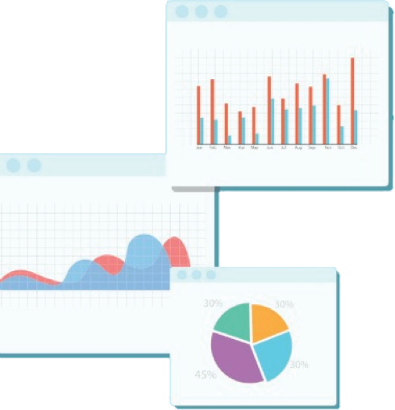


Welcome to Week 12
Lecture 1!
Data Science in Python &
Machine Learning

Slide 3
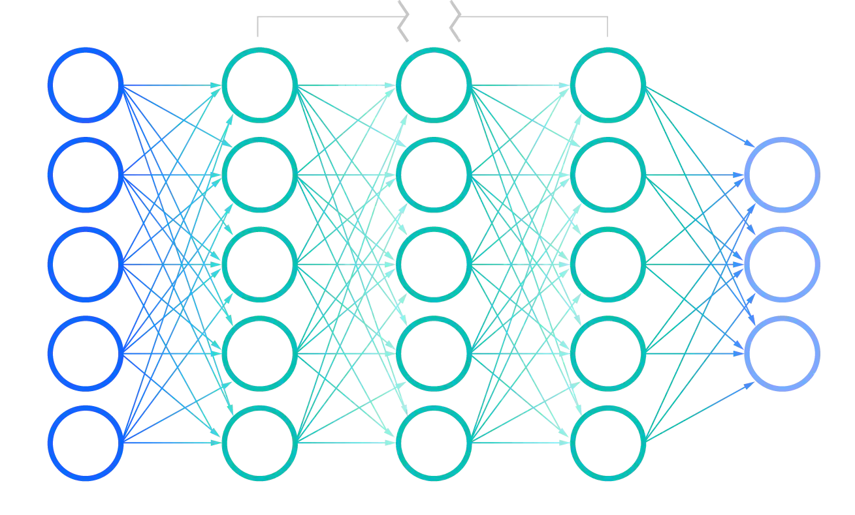
Neural Network Review
Breakout!
Your group will contribute to a review of neural networks
Each group will contribute a different part.
Forward Propagation
Backward Propagation
Regression in neural networks
Binary classification in neural networks
Choose a reporter to type your answers into:
This Padlet!
Image Source
You have 5 minutes!

Slide 4
Learning Objectives
After this lesson you should be able to:
Describe a relational database and how is it organized
Explain ‘keys’ and what they are used for
Use SQL to retrieve specific data from a relational SQL database.

Slide 5

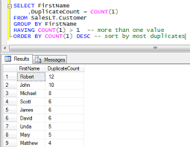
Structured Query Language
Language to interact with SQL servers.
Inputs, retrieves, and manages data on SQL databases

Slide 6
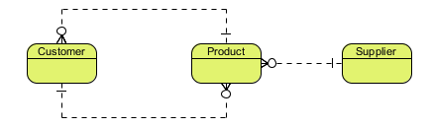
Benefits of a Relational Database.
Contains multiple tables
Tables are related to each other in well defined ways.

Slide 7
Benefits of a Relational Database.
Works well with highly structured data
Reduces redundancy in data and promotes consistent data entry.
Data can be efficiently accessed, retrieving only the data desired.

Slide 8
Entity Relationship Diagram (ERD)
An map of all tables and relationships between tables
Entity: A ‘thing’. Could be:
It can be a person, thing, concept, or event.
Such as: Customers, Sales, Products, Locations…etc
Each “entity” has its own table.
Each table contains the attributes (like features) associated with the entity
Entity
Attribute
Attribute
Attribute
Customer
Cust_ID
Name
Email
Phone
The entity is “Customer”
Each customer will have 4 attributes

Slide 9
Different levels of ERD
Conceptual Data Model - big picture, shows key relationships, but no attributes
Image Source

Slide 10
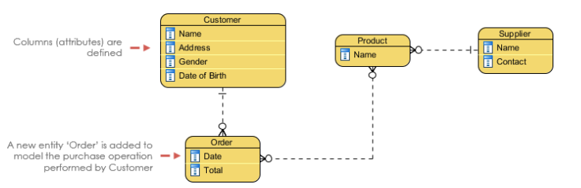
Different levels of ERD
Logical Data Model - includes attributes
Image Source

Slide 11
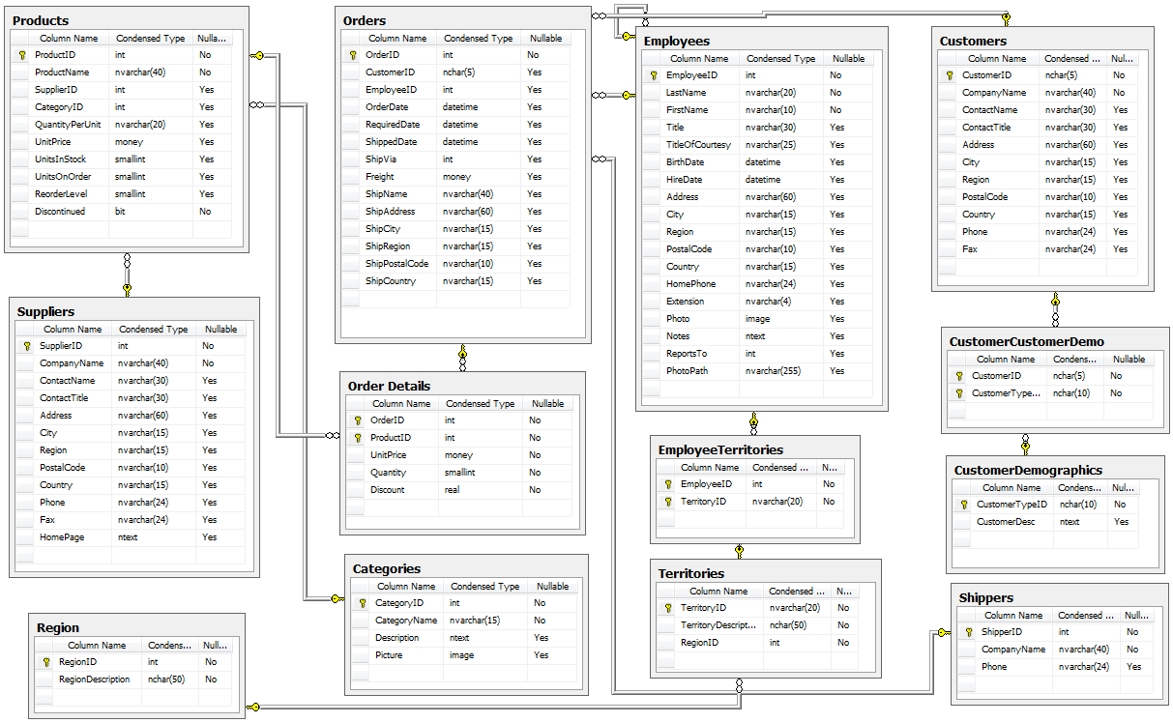
Different levels of ERD
Physical Data Model - Includes data type and primary or foreign keys
Image Source

Slide 12
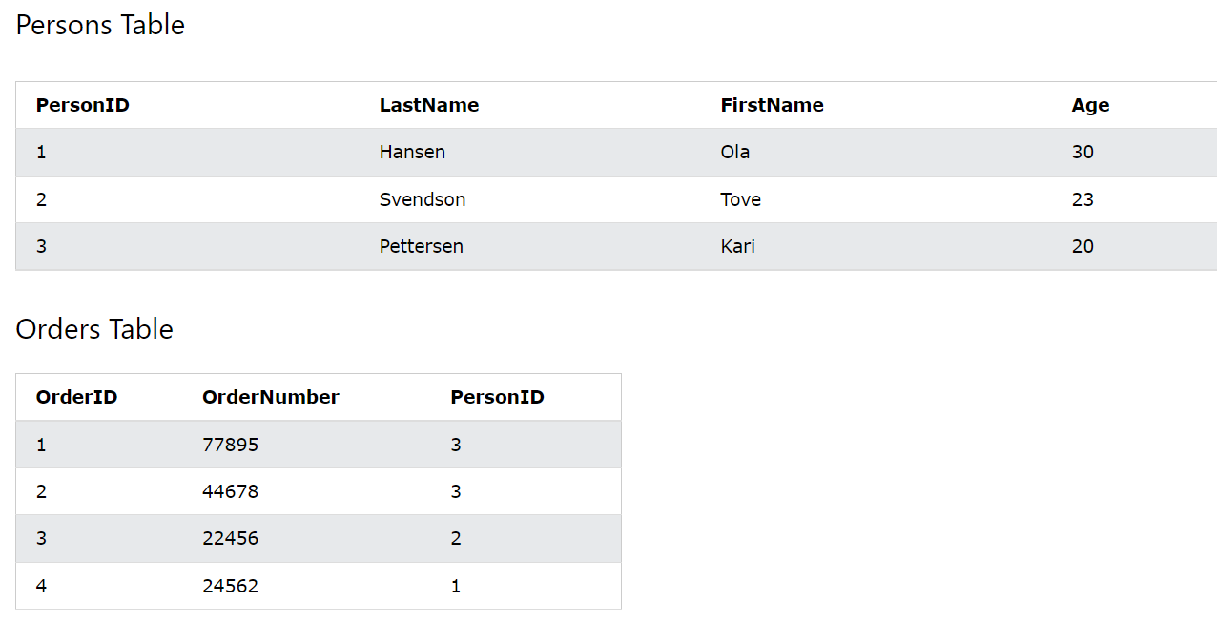
Keys link one table to another
Primary key of persons table
Primary keys
Must be unique (like an ID number)
Must be present, no null values
Only one per table
Foreign keys
A field in a table that references the primary key in another
Must match a primary key
Foreign Key in Orders table referencing primary key in Persons table
Notice how every time an order is placed, we don’t need to repeat all the customer info. We can just link to it with the foreign key.
Image from W3Schools

Slide 13
Cardinality
Cardinality is how many times an entity exist in relation to another entity
One to one (1:1)
One record only associated with one record in another table
Example: Each Cust_ID in the Customers table can only be related to one entry in the Contact table
One to many (1:M)
One record can be associated with more than one record in another table
Example: Each Cust_ID can be associated with multiple orders
Many to many (M:M)
Multiple records on both tables can be associated multiple records on the other table.
Requires an additional connector table
Example: One order can include multiple products and one product can be ordered multiple times.
Check out this link at Database Star for examples of various notation methods for representing cardinality and different types of ERDs.

Slide 14
Knowledge Check:
Relational Database Poll

Slide 15
SQL Queries

Slide 16
How to Display a Table from a SQL Database
SQL is a ‘Query’ language that allows users to retrieve, add, or manipulate data on a SQL server.
SELECT - select the data from the database and display the result based on the condition
SELECT *
FROM table_name;
Select all the columns from the table_name and display
SELECT col1, col2, …
FROM table_name;
Select col1, col2, … from the table_name and display

Slide 17
Resources
SQL CheatSheet
SQL Island
Change language to ‘English’
SQLZoo
SQL practice and a great tutorial
Will be required in Stack 4

Slide 18
Code-along Example

Slide 19
Summary
Relational databases contain many related tables and store data very efficiently
Keys define the relationships between tables and can be used to join multiple tables into one when retrieving data
SQL is a query language to interact with relational databases on SQL servers to retrieve, input, or manage data.

Slide 20
Announcements
ALL assignments due Friday, 9am.
Including all resubmits Weeks 1-3
Presentations on Thursday!

Slide 21
Presentations:
Non-technical:
No technical jargon,
Graphs interpretable by anyone
Only what you would have understood before starting this program
5 minutes: Hard stop!
Examples:
Stroke Prediction

Slide 22
Daily Schedule
Complete your Environment Setup Assignment! AS SOON AS POSSIBLE

